Slide 1
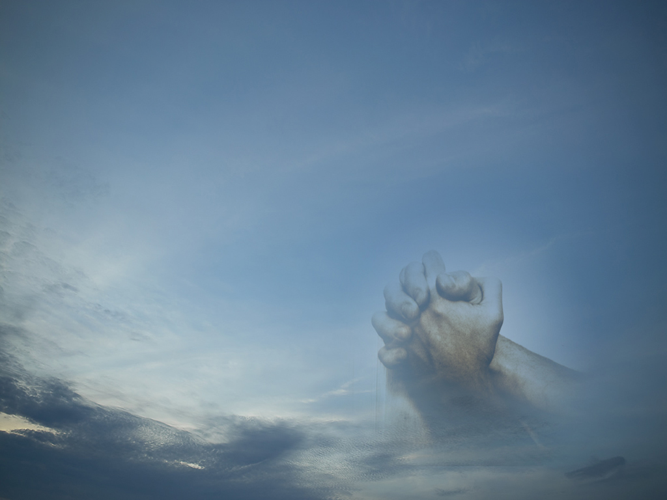
WORSHIP:
Life’s Greatest Moments
Ascribe to the LORD, O families of the peoples,
ascribe to the LORD glory and strength!
Ascribe to the LORD the glory due his name;
bring an offering, and come into his courts!
Worship the LORD in the splendor of holiness;
tremble before him, all the earth!
Psalm 96:7-9

Slide 2
WORSHIP: Life’s Greatest Moments
What is “WORSHIP”?
The English word comes from the old word “worthship”!
It is by our words and actions telling God that He is worthy of our praise and adoration. He deserves our love and thanksgiving.
It is action motivated from the heart, with the knowledge of who God is and what He has done for us.
It is a mental act, a sense of awe and reverence in the presence of the DIVINE.

Slide 3
WORSHIP: Life’s Greatest Moments
What is “WORSHIP”?
William Temple said…
“To worship is to quicken the conscience by the holiness of God, to feed the mind with the truth of God, to purge the imagination by the beauty of God, to open the heart to the love of God, to devote the will to the purpose of God.”
Read… Psalm 95:1-7
  Reminds us of our need to worship God!

Slide 4
WORSHIP: Life’s Greatest Moments
(Text: Acts 4:23-31)
4 Significant Phrases:
  A response to God’s help.
  A praise of God’s power.
  An application of God’s Truth.
  A re-dedication to God’s service

Slide 5
WORSHIP: Life’s Greatest Moments
WORSHIP… acknowledgment of God’s help!
  Every Christian can see God’s wonderful blessings. (Psalm 23; 46:1; 121)
  We must ALL thank God for ALL He has offered us…because we need HELP!

Slide 6
WORSHIP: Life’s Greatest Moments
WORSHIP exercises… praise for God’s power!
  Every act of worship should praise God’s power! (Heb.13:15; 1Pet.2:9; Isaiah 25:1; Psalm 117:148)
  We often sing songs of praise, yet never “listen” to what we sing. (Psalm 148)

Slide 7
WORSHIP: Life’s Greatest Moments
WORSHIP… makes personal application!
  God designed these times for us to gain strength in order to… face the situations of life… to gain strength when we’re weak (1Cor.10:6-13; Eph.3:14-21; John 14:1-6)
  Worshipping assemblies are designed by God to help us live a better life, NOT feel “good” about living a self-centered life. (Heb.10:24-25)

Slide 8
WORSHIP: Life’s Greatest Moments
WORSHIP… prods us to rededicate & recommit!
  How will we respond?
  Many desire nothing & and get nothing

Slide 9
WORSHIP:
Life’s Greatest Moments

